Slide 2
KubeEdge DeepDive: Extending Kubernetes to the Edge with Real World Industry Use Case
张红兵Hongbing Zhang, DaoCloud
鲍玥Yue Bao, Huawei Cloud

Slide 3


About Us
Hongbing Zhang
- TSC Member of KubeEdge
- COO of DaoCloud
- Github: @HongbingZhang
Yue Bao
- KubeEdge Maintainer
- Senior Software Engineer of Huawei Cloud
- Github: @Shelley-BaoYue

Slide 4






Background
Home
ACC
AGG
Metro
Enterprise
~50km
1~5ms
50~200km
5~10ms
eNodeB
>200km
>20ms
Nearside Edge
City Edge
Regional Edge
Cloud
EDGE
MEC
MEC
MEC
Cloud
Services
Cloud Services
Millions
Hundreds-Thousands
Tens- Hundreds
tens
Typical Apps
V2X, AR/VR, AI
AI Inference
vCDN, AR/VR
Rendering, Video transcoding
AI Training , Big Data
AI Training/Inferencing, Video transcoding

Slide 5













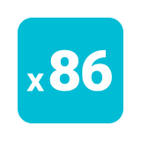



The KubeEdge Project
Flexible quality inspection
OCR
Facial Recognition
Behavior Analysis
…
KubeEdge - EdgeCore
KubeEdge - CloudCore
Device
Management
Edged
Meta Manager
Cloud - Edge
Coordination
CloudHub
DeviceController
EdgeController
EventBus
DeviceTwin
EdgeHub
Data Access
The first Cloud Native Edge Cloud Computing OSS Project
Open Governance, connecting Cloud Native and Edge Computing Ecosystem
7,600+ stars, 2,100+ forks on GitHub
1500+ contributors (350+ code committers) from 100+ organizations
Edge Computing scenarios oriented, designed for edge-cloud collaboration
Consistent experience of Applications, Resources, Data, Devices, etc. Collaboration between cloud & edge

Slide 6
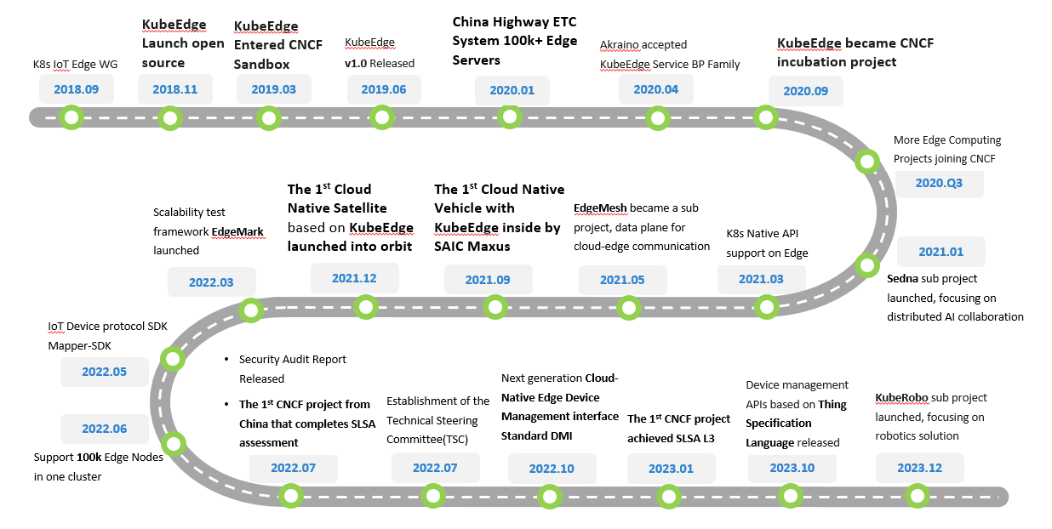
Innovative project journey

Slide 7
Multi Domain, Multi-Scene, Edge Computing Platform
Intelligent Transpiration
Smart Energy
Smart City
Smart Campus
Industrial Intelligence
. . .
Industry Scenario-based Kit
AI
IOT
MEC
Robotics
. . .
Edge-Cloud AI Kit
Sedna
IOT Kit
Event framework
Edge-Cloud Data plane
EdgeMesh
Edge Cloud Messaging
Robotics Kit
. . .
Extensible Core Framework
Edge-Cloud Scheduling: Resources, Traffic
Edge-Cloud Orchestration: Unified orchestration, Auto-Scaling
Compatibilityy & Conformance
Application Compatibility
Software Conformance
Hardware Compatibility
Core framework: Edge-autonomy, Shadow mgmt.
Edge Runtime: Containers, VMs, WASM
Edge
Mgmt.
Edge Clusters mgmt.
Heterogenous
Hardware
ARM/x86/Kunpeng
Leaf
Devices
Devices Access
Heterogenous Resources Support
Edge Nodes mgmt.
GPU/NPU/Ascend
Device Modeling
Mgmt. plugins
FPGA and others …
Plugins for Protocols
Linux
Windows
Android
openHarmony
RTOS
. . .
X86
Arm32
Arm64
RISC-V
. . .
Already provided
Roadmap

Slide 8
Project introduction and updates

Slide 9
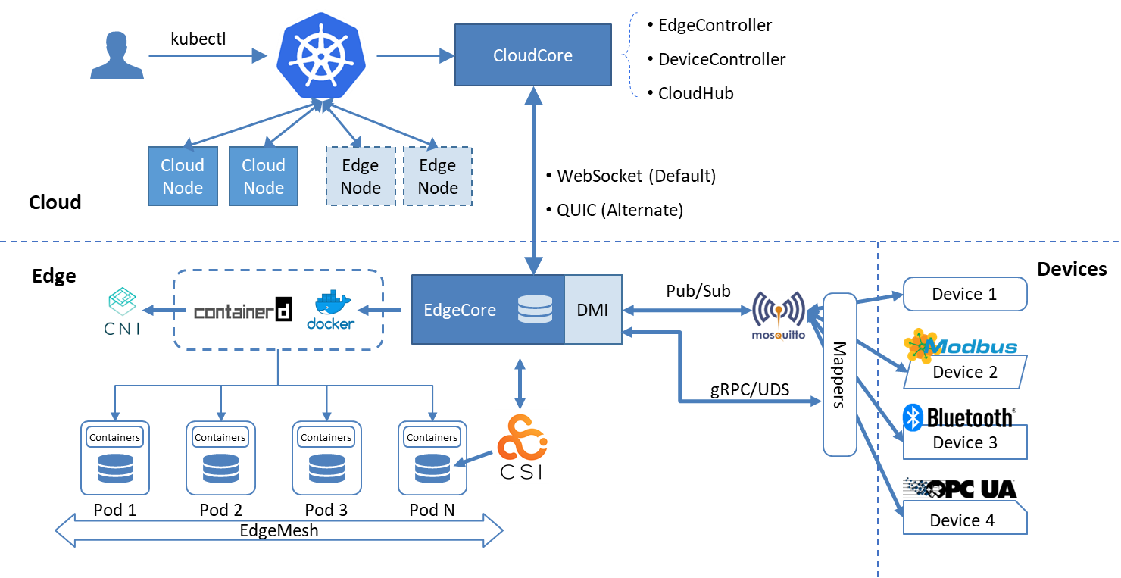
KubeEdge Architecture
Seamless Cloud-Edge Coordination
Edge Autonomy
Low Resource Readiness
Simplified Device Communication
Open Ecosystem

Slide 10

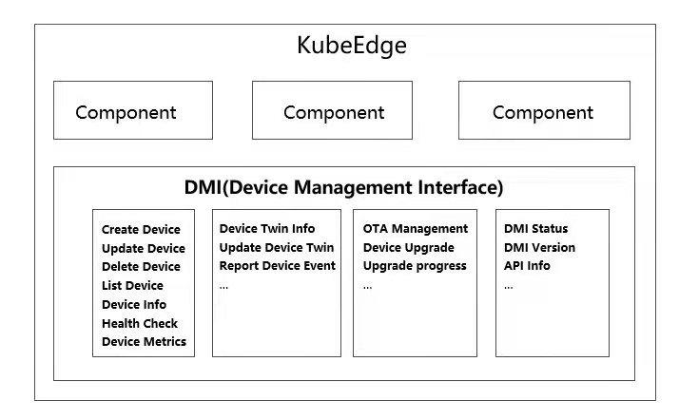
SIG Device-IoT: Device Management Interface (DMI)
DeviceModel API (CRD)
Device API (CRD)
KubeEdge Cloud Cluster
Decoupled control plane and data plane for IoT devices
Device (data) as a Service
Help developers to focus on their own application development
Reduced channel congestion between cloud and edge
A more flexible and unified way to manage IoT Devices
Device Controller
Cloud Hub
Data APP
in Cloud
Cloud
Kubernetes
Edge
EdgeCore
EdgeHub
Device Manager（Device Twin）
Data
over
EdgeMesh
MQTT Broker
DMI API (Rest)
Data APP
on Edge
Data
over EdgeMesh
Mapper Container
Device Modelling
Data Collection
Data Forwarding
plugins
OPC-UA plugin
Bluetooth plugin
Modbus plugin
https://www.cncf.io/blog/2022/10/05/kubeedge-design-and-implementation-of-the-next-generation-cloud-native-edge-device-management-standard-dmi/
Features updates:
New Device APIs, including build-in protocols kile Modbus, Opc-UA and Buletooth
Mapper supports video streaming data reporting
Support mapper upgrade

Slide 11
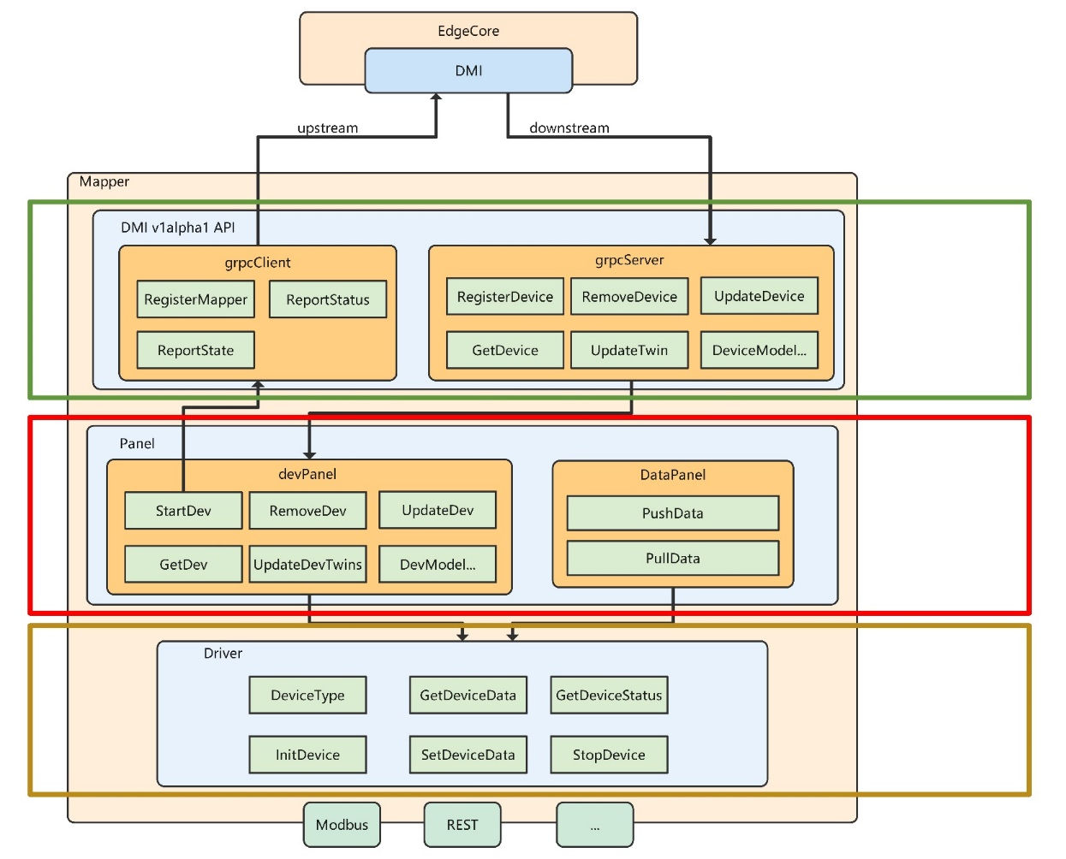
KubeEdge Mapper Design Overview
API
DMI implement
Report to DeviceTwin
Manage device lifecycle
ControlPlane & DataPlane
Define DevPanel module，connect to DMI and device driver
Define DataPanel module，include data process capability
Device Driver
Exposes the Device Driver interface to users to meet the access needs of various types of IoT devices

Slide 12
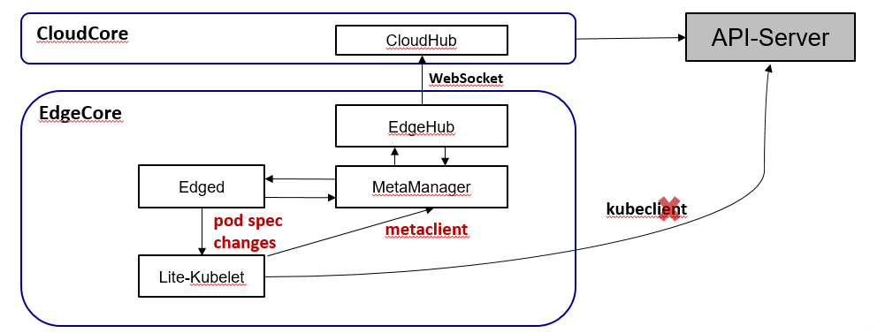
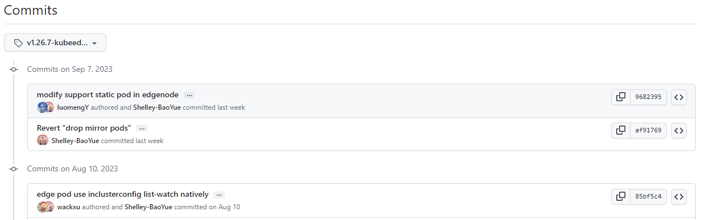
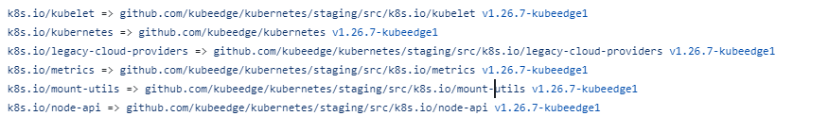
SIG Node: Edge Architecture
Cloud
CloudHub
Global Store
WebSocket
EdgeHub
MetaManager
kubeedge/kubernetes
Edge Store
DeviceTwin
Meta Server
K8s Operator
Edged（Kubelet-Lite）
Doc ker
Containerd
CRI-O
kubeedge/kubeedge go.mod
Runtime
Runc
Kata
Runv
Features updates:
Support image pre-pull on the edge
Support Auto-Restarting for edge modules
Support more deployment fields override for edgeapplications

Slide 13
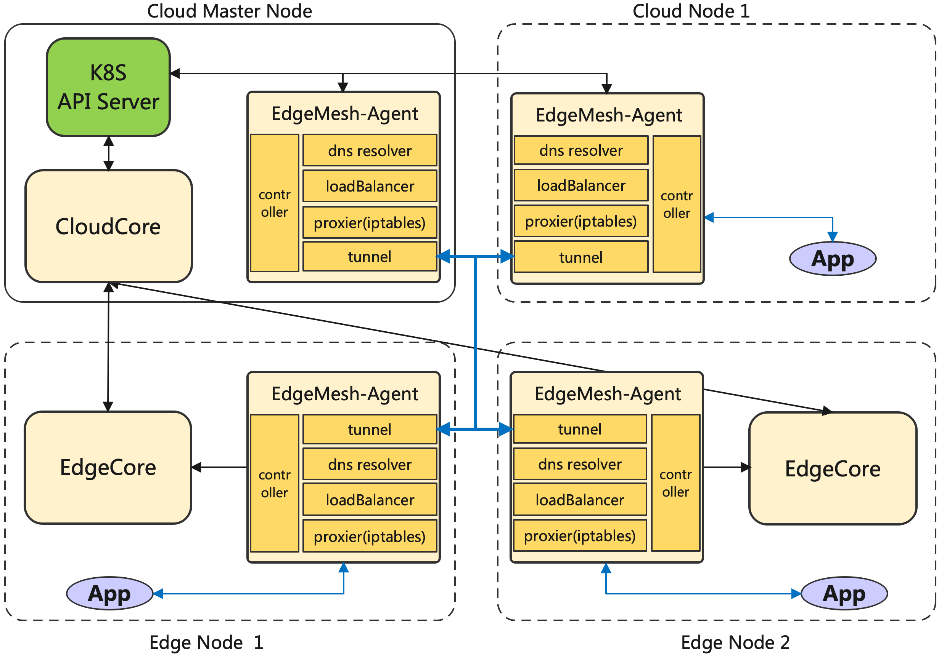
SIG Networking: Edgemesh, adaptive multi-edge/cloud-edge network
"Serverless" design, adaptive multi-edge and cloud-edge network Tunneling
Built-in edge local DNS resolution, independent of central DNS
Consistent service discovery and access experience across the edge and cloud.
Supports Layer 4 and Layer 7 traffic management.
Multi-edge and cross-subnet communication
WIP: Supports standard istio for service governance.

Slide 14




SIG Security
One of the first CNCF Project integrating with Fuzzing
https://www.cncf.io/blog/2022/06/28/improving-
security-by-fuzzing-the-cncf-landscape/
One of the First CNCF project reaching L3 of Supply Chain Levels for Software Artifacts (SLSA)
Source, Build and Common All reached L4
KubeEdge Full Audit Report
https://github.com/kubeedge/community/tree/master/sig-security/sig-security-audit/KubeEdge-security-audit-2022.pdf
KubeEdge Threat Model And Security Protection Analysis
https://github.com/kubeedge/community/blob/master/sig-security/sig-security-audit/KubeEdge-threat-model-and-security-protection-analysis.md
KubeEdge Security Policy and Vulnerability Management
https://github.com/kubeedge/community/blob/master/security-team/SECURITY.md

Slide 15
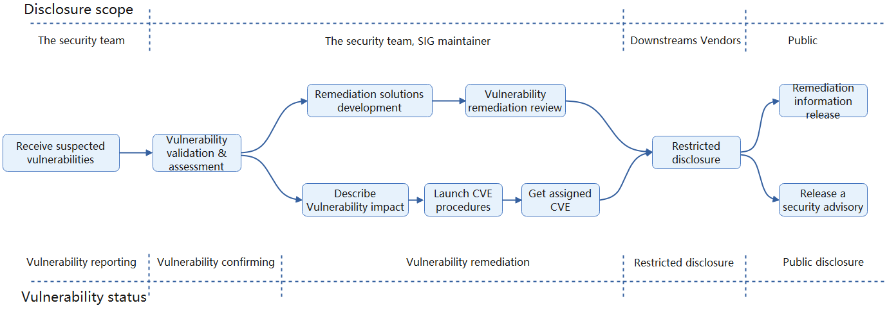

SIG Security
KubeEdge Security Policy and Vulnerability Management
https://github.com/kubeedge/community/blob/master/security-team/SECURITY.md

Slide 16
Edge AI

Slide 17
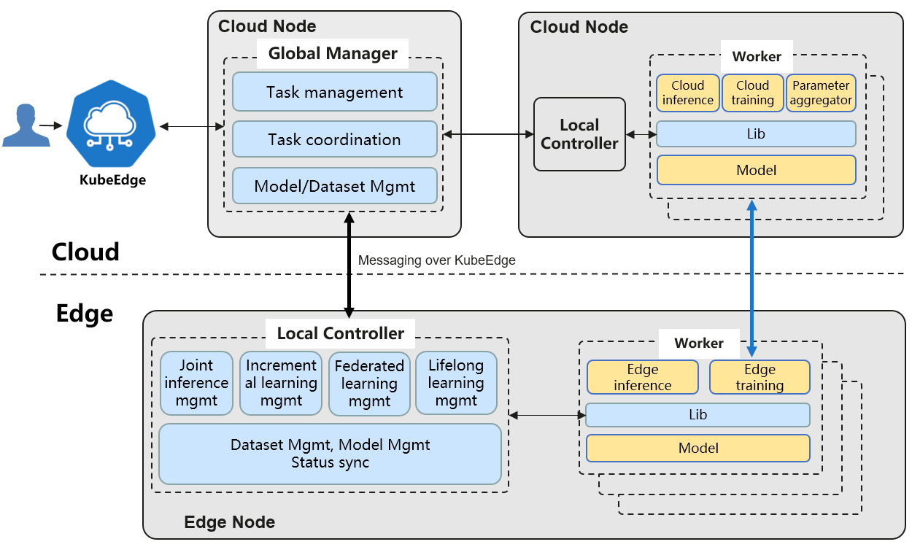
SIG AI: Sedna, Distributed AI collaboration Kit
AI framework fueled by edge-cloud synergy
Dataset and model management across the edge and cloud
Training and inference frameworks fueled by edge-cloud synergy
Joint inference
Incremental learning
Federated learning
Lifelong learning
Open ecosystem
Compatible with mainstream AI frameworks: TensorFlow, PyTorch, Paddle, MindSpore, etc.
Provides extended interfaces for developers to quickly integrate third-party algorithms

Slide 18
Cloud-Edge Collaboration Lifelong Learning
Knowledge Lib
For small sample size and heterogeneous edge data:
Knowledge lib in cloud provides memory. The sample knowledge accumulated on the edge is continuously updated and persistently stored, thereby mitigating the problem of catastrophic forgetting.
By combining incremental training and multi-task training, as well as cross-temporal and cross-scenario knowledge transfer, it’s able to better handle unknown tasks.
1
Cloud
2
3
4
Unseen Task Processing
Edge
Unseen Task
Detection
Unseen Task
Detection
Unseen Task
Detection
Unseen Task
Detection
Unseen Task
Detection
Inference
Inference
Inference
Inference
Inference
Task Model
App @Edge A
App @Edge B
App @Edge A
App @Edge C
App @Edge D
Task Sample
…
…
T-N
…
T-2
T-1
T
T+1
T+2
…
T+M
Time
Edge Node A
Edge Node B
Edge Node A
Edge Node C
Edge Node D
N history task
Current task
M future task

Slide 19
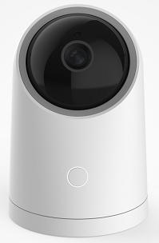
Cloud-Edge Collaboration Federated Learning
Multi-task detection, divide the Non-IID sample set, and cooperate with the cloud to recognize similar tasks
Local training, upload model parameters to the cloud, and cloud runs cross-edge migration + model aggregation algorithms
Isolated data does not leave the edge
Knowledge aggregation produces the model
Edge 1
app
model
Cloud
Aggeration Algo
Labeling
Service
local samples
local incre-training
Algo
models parameters updating
Developers: import the edge AI Lib, develop edge-cloud collaboration federated learning program
Launch the federated learning task, deploy the training program to edge
Edge 2
Labeling
Service
local samples
local incre-training
Algo
Sedna Federated-Learning Service API
app
model

Slide 20
Cloud-Edge Joint-Inference
Under resource-constrained lateral conditions, improving overall reasoning performance.
Perform inference with shallow model on the edge, and if the confidence level is met, directly return the result
Otherwise sent the data to cloud and inference with cloud large model
Edge 1
App
Shallow Model
Hard example mining
Cloud
Edge 2
App
Sedna
Joint-Inference
API
Developer
Shallow Model
Hard example mining
Deep Model
大模型
推理
大模型
推理
AI developers：provide data to train deep models and shallow models
Business developers：call the joint-inference models through Sedna lib and deploy them to edge
Edge 3
App
Shallow Model
Hard example mining

Slide 21

SIG Robotics
KubeRobo: A Cloud-Native Robotics Management Solution, Empowering RoboDevOps Through Edge-Cloud Synergy
Development
Management
Deployment
Locally Consistent Dev Experience
Deploy
Streamlines robotic app development with cloud-native technology
RoboDev
Develop
RoboAI (Sig AI)
Data transport
Pre-built environment
Sedna
Ianvs
Convenient R&D in Simulation
Local IDE integration
Edge-Cloud distribution
Multi-sensors Dataset
Deploy
RoboOMS
Robust CI/CD
EdgeAI framework
AI Benchmark
Data Collection/Mining
Provide a cloud-native digital twining framework for research and development of robotics solutions, applications and skills
Testing
Training
Deploy
Data transport
Application Scheduling
RoboSim
RoboSkill
Resource Management
Robot/Env Modeling
Training
Control/Motion planning
Data generation
Perception and Cognitive
Out-of-the-box Robot Skills
Multi-Agent Learning
Multi-Agent Collaborative
Provide best practices of multi-agent collaborative robot skills
Cloud
Edge
Messaging over KubeEdge/EdgeMesh
Efficient Robot Operation Management
KubeEdge Node
KubeEdge Node
APP A
APP B
. . .
APP A
APP B
. . .
Unified access of heterogeneous robots and collaborative management of Multi-Agent
Robot Operating System
. . .
Robot Operating System
Hardware
Hardware
Motor
Controller
Sensors
Motor
Controller
Sensors

Slide 22
Case Studies

Slide 23
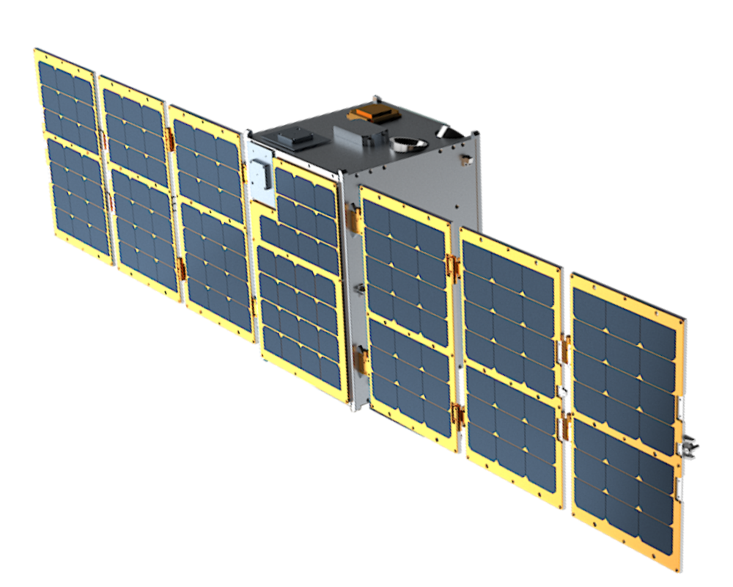




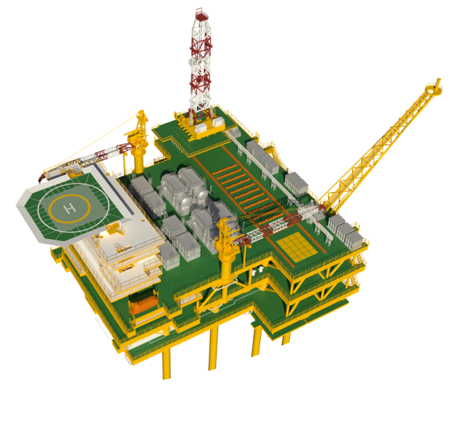

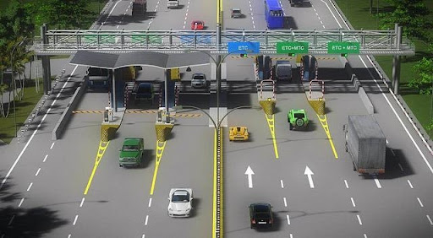
New Boundaries: More traditional Industries to Cloud Native
Intelligent Transpiration:
China Highway ETC system
Hong Kong-Zhuhai-Macao Bridge
Ci4Rail GmbH: Rail and Public Transportation
Smart Energy:
CNOOC Limited: Cloud Native Offshore Oilfield
Jingying Shuzhi: Coal Mine Brain
Industrial Intelligent:
Sanlian Hope: Flexible Visual Quality Inspection
Raisecom: Smart Factory
National Industrial Internet Big Data Center
Smart CDN:
China Telecom eCloud: Smart CDN
Cloud Native Vehicle:
SAIC Maxus: Cloud Native SOTA
LEO Satellite:
Sky Computing Constellation: Cloud Native Satellite
Smart Campus:
XingHai-IoT: Smart Campus/Community
Financial:
CCB China: Smart Bank
Smart logistics
SF Express
ZTO Express
Chemical Plant:
East Hope: Digital factory
Power Industry:
China Southern Power Grid
Accelerators:
Vastaitech: Edge AI Accelerator
Others:
CMCC: Smart Video Cloud
CMCC: 10086.cn, customer service platform
Cloud Native Satellite
Cloud Native Vehicle
Cloud Native Offshore Oilfield
Smart CDN
Electronic toll collection

Slide 24


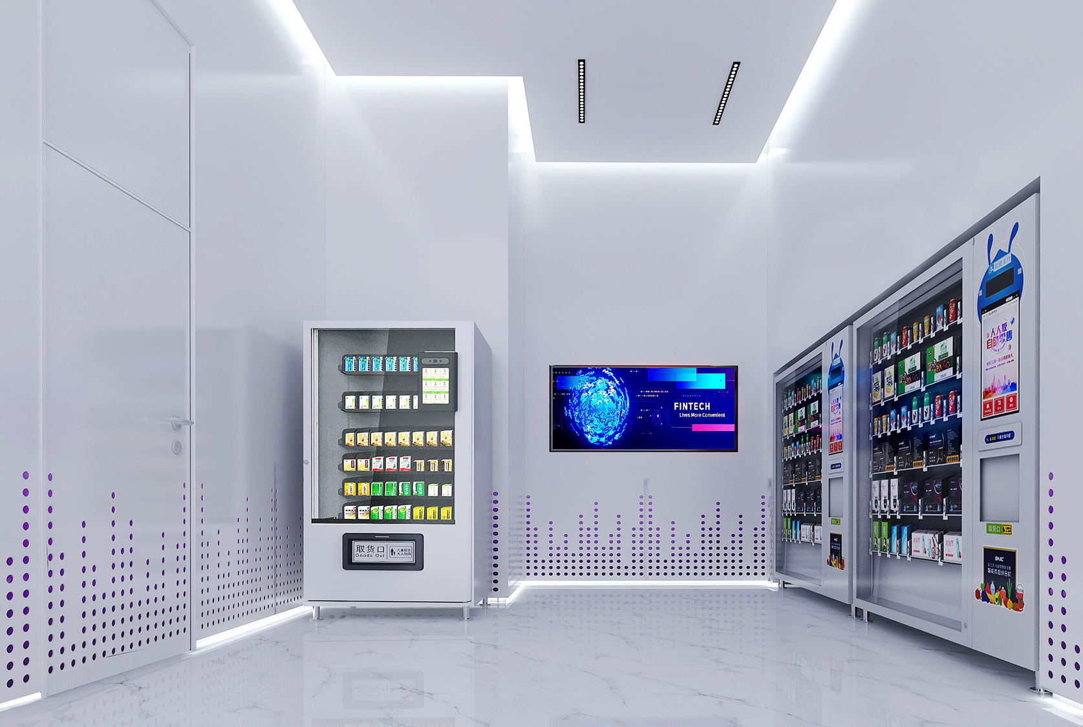



Cloud Native into the life: Smart Retail
Cloud
Digital Platform
KubeEdge
CloudCore
Requirements：
By installing cameras at appropriate locations in the store to monitor the foot traffic for each advertising screen
Transmitting the monitoring data of each device to the platform.
The attention rate of each advertising screen
The foot traffic of each screen
User benefits：
High Efficiency and Low Coupling
Computing and business capabilities are decentralized, leading to fast response times and low coupling.
Store Business Autonomy
In complex network environments, stores have independent control over their marketing videos, ensuring high stability.
Integrated Operations and Maintenance
Edge node and application monitoring, unified management and analysis of logs in the cloud, rapid fault location, and enhanced operational efficiency.
Statistical Data Push
Rule Sync
Manage & update APP
Edge ( Store )
Reasoning
Service
KubeEdge Edge Agent
Control
Device
Video Stream
Advertising Screen
Camera
Customer

Slide 25
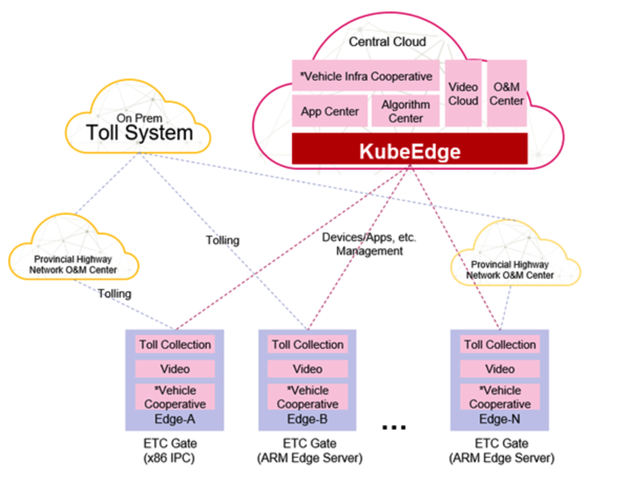
Build network of expressway system
Challenge：
Manage 100,000+ heterogeneous nodes: x86, ARM, et.al
Manage 50000+ applications
Competitiveness:
Low latency
Heterogeneous nodes
Unified management
User Values:
Edge-cloud collaborative architecture allows for flexible expansion of solutions
A single network for the national expressway system
Effectively improve efficiency by nearly 10 times, reducing the passage time for each vehicle to 2 seconds.

Slide 26
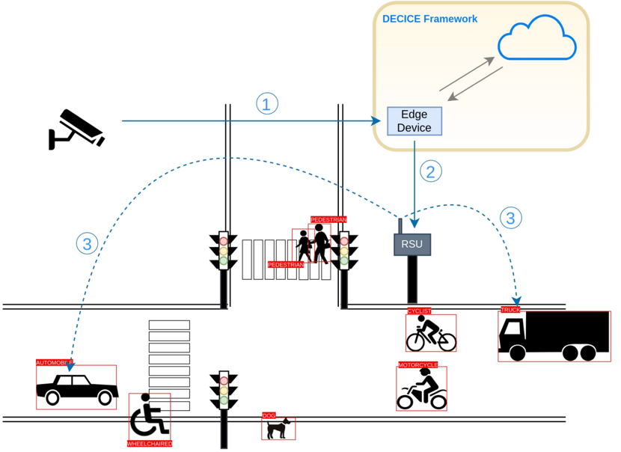
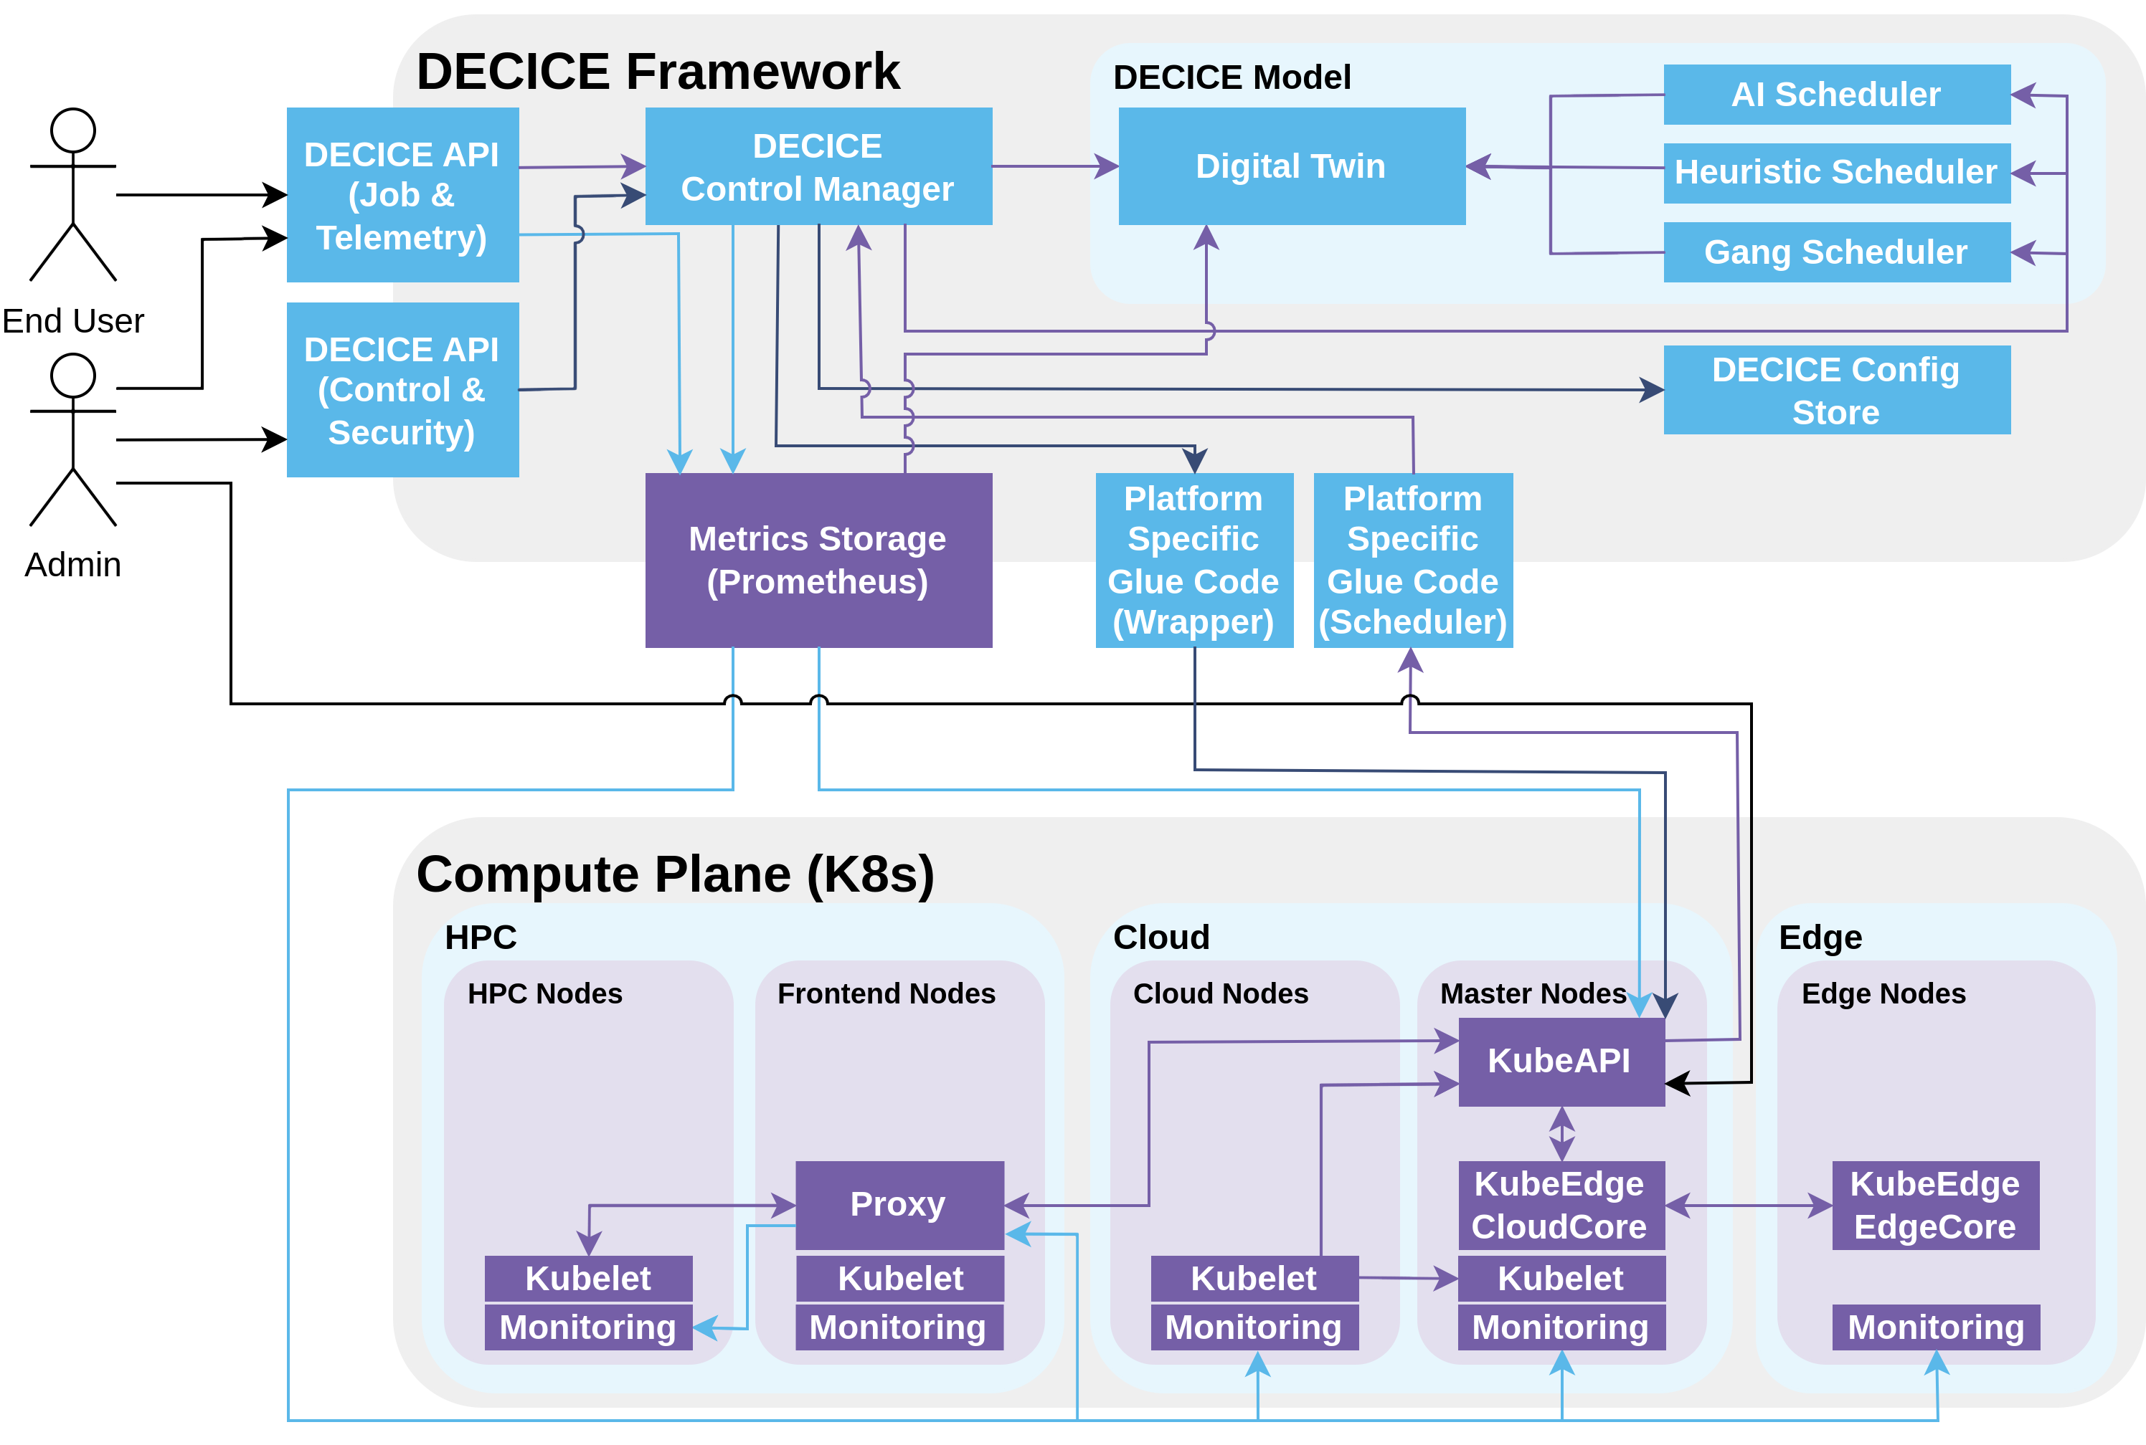
Intelligent Intersection with VRU Detection
1. Camera(s) continuously monitor the intersection
a. Edge device(s) processes visual data and detects objects (VRU, vehicle, etc.)
2. Detection information is shared with RSU
3. RSU broadcasts this information to nearby vehicles wirelessly.

Slide 27




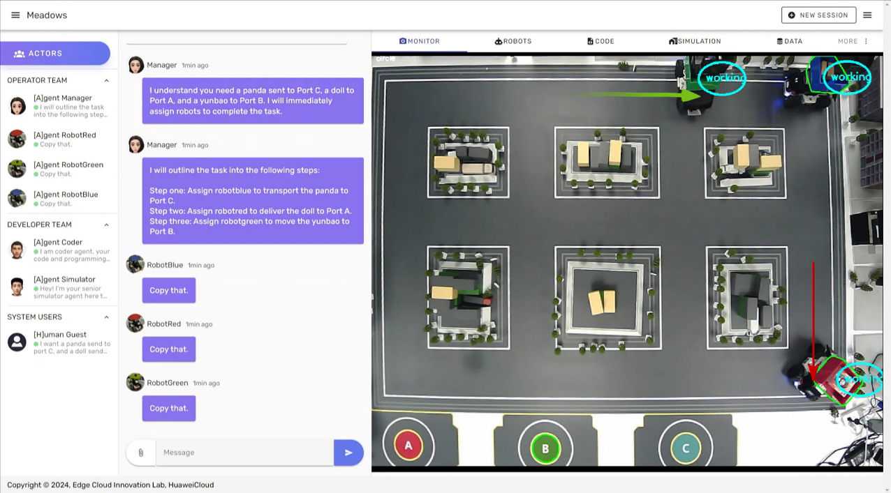

KubeEdge Based Orchestration Across Multiple Cloud Native Robots
KubeEdge
Cloud
Warehouse (edge)
Robots (edge)
Challenges
Difficult for robots to comprehend natural language
Risk of robots congestion due to increased deployment scale
Difficulties in accessing & managing diverse robots
NLP with LLMs
Flow prediction & control
tasks assignment
route planning
Heterogeneous robot connected
Benefits
NLP-driven task understanding & task execution based on multi-robot coordination
E2E deployment cycle of cloud-edge system reduced 30%
Robots management efficiency improved 25%
Integration cycle for new robots shortened from months to days

Slide 28
Managing a Large Number of CDN Nodes on China Telecom Tianyi Cloud
CloudCore multi-replica balancing
CloudCore deployment in multi-replica mode
Multiple clusters for load balancing and high availability
Edge infrastructure construction
Hybrid deployment of edge computing and CDN nodes
Node-level service mesh
Complete container isolation and security
Ingress-based and universal CDN gateways
Virtual CDN edge resources
Unified resource scheduling platform for CDN and containers
CDN PaaS platform
Nodes
Container orchestration
Monitoring
Central Cloud
Apps
Images
Logs
Region
Region
Kubernetes
Kubernetes
Region
CloudCore
CloudCore
CloudCore
CloudCore
CloudCore
CloudCore
CDN node 1
CDN node N
CDN node 1
CDN node N
EdgeCore
EdgeCore
EdgeCore
EdgeCore
CDN
Nodes
Audio/Video app
Audio/Video app
Audio/Video app
Audio/Video app
Web app
Web app
Web app
Web app
Live app
Live app
Live app
Live app
Content distribution
Content distribution
Content distribution
Content distribution

Slide 29
Achievements Built on a Thriving Community

Slide 30
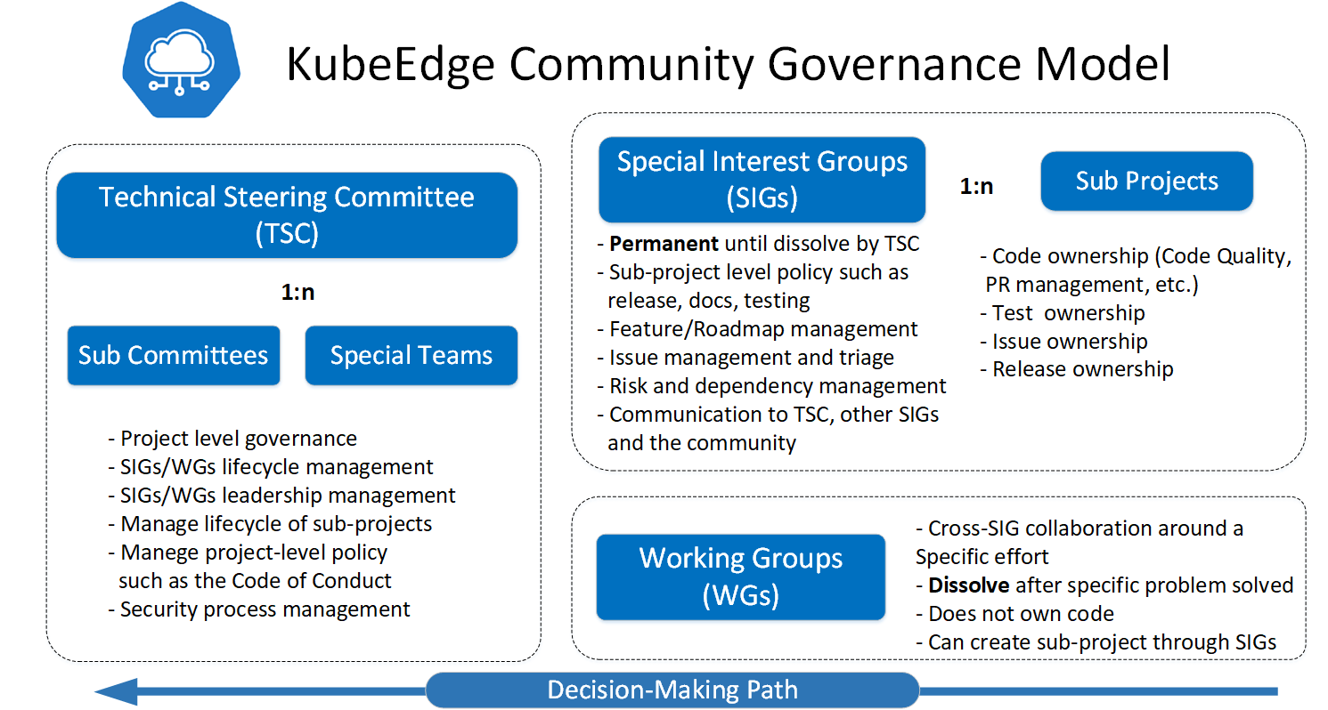
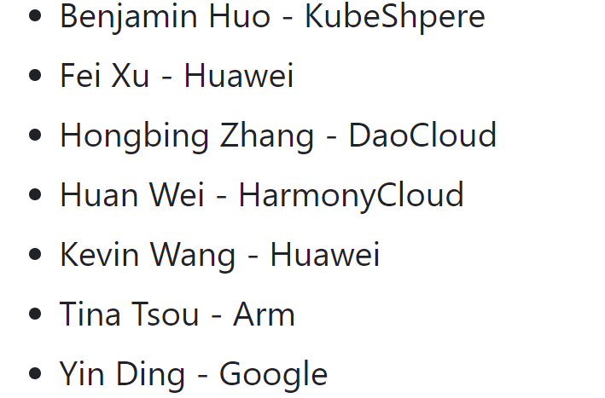
Open Governance
TSC Members
11 SIGs
SIG Node
SIG Device-IOT
SIG Networking
SIG Scalability
SIG Security
SIG Robotics
SIG AI
SIG MEC
SIG Release
SIG Testing
1 WG
WG wireless

Slide 31














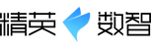



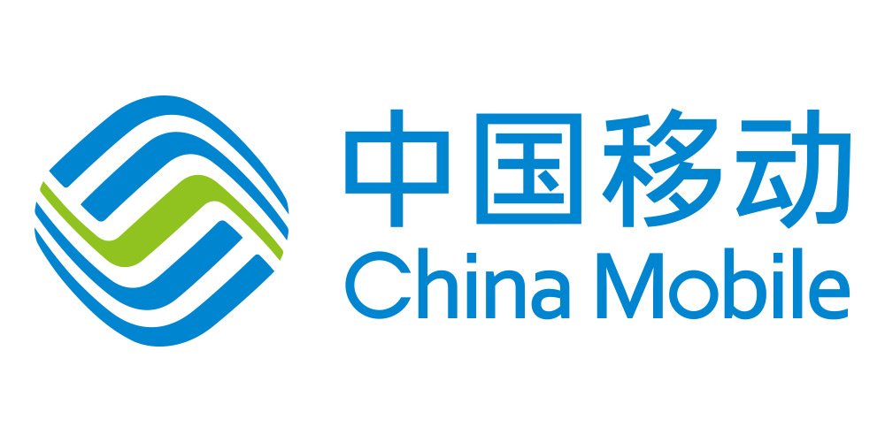































Diverse Partnerships Across Industry, Academia and Research

Slide 32
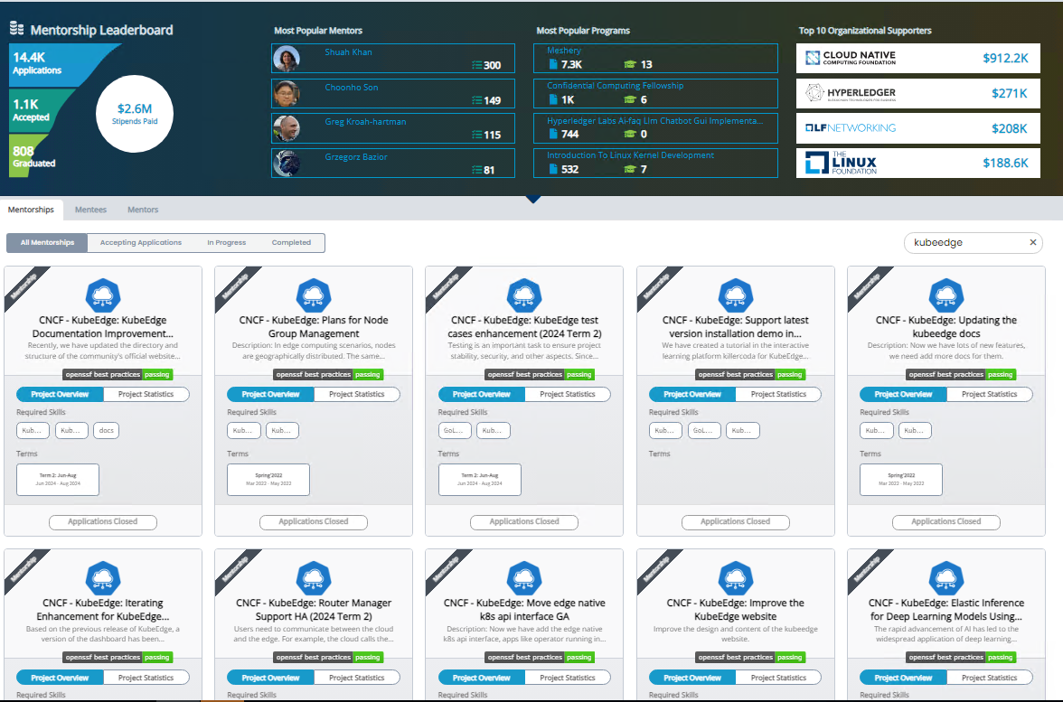


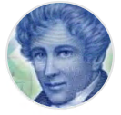


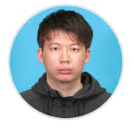



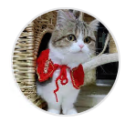



More Activities
Participated in the LFX Mentorship program for 4+ years, providing 20+ projects, Covering multiple areas including feature development, documentation, testing, frontend, and more.
Looks forward to joining forces with emerging talents in the field of computer science to explore the digital future
https://kubeedge.io/partners
Notes:
我想最后那个part，可以再放点毕业、LFX、官网的合作伙伴 案例中心这些活动，看看你们有没有什么想法和建议，可以直接刷上去

Slide 33
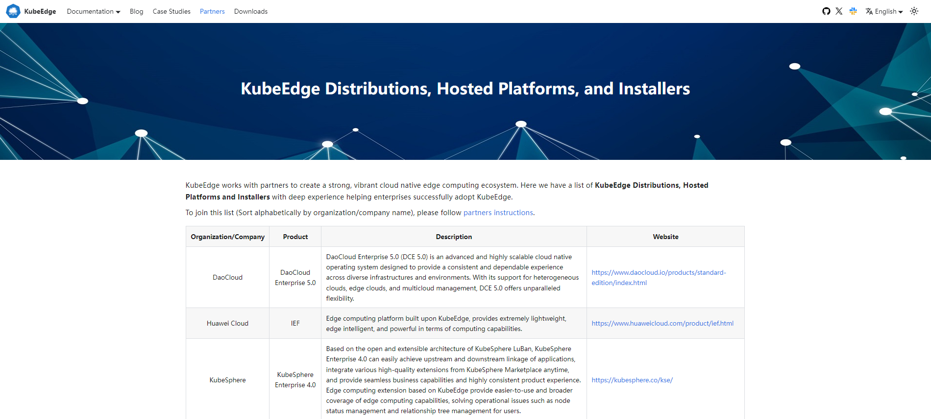
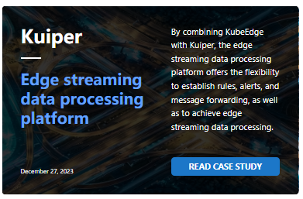
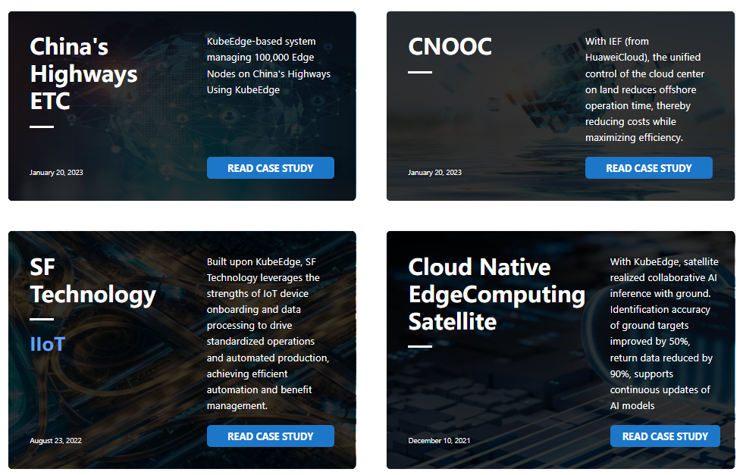
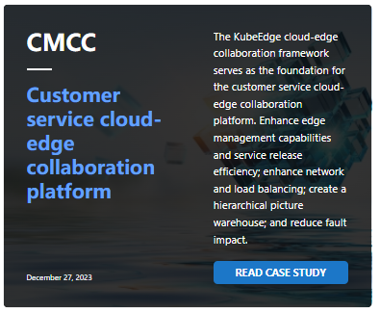
More Activities
Partners
Works with partners to create a strong, vibrant cloud native edge computing ecosystem.
List of KubeEdge Distributions, Hosted Platforms and Installers
Join it if you have the related product
https://kubeedge.io/partners
Case Studies
https://kubeedge.io/partners
Designed to show successful cases of users who have implemented KubeEdge in their business scenarios
Learn how to use KubeEdge in real scenarios
Share your successful cases with other users
https://kubeedge.io/case-studies
Notes:
我想最后那个part，可以再放点毕业、LFX、官网的合作伙伴 案例中心这些活动，看看你们有没有什么想法和建议，可以直接刷上去

Slide 34
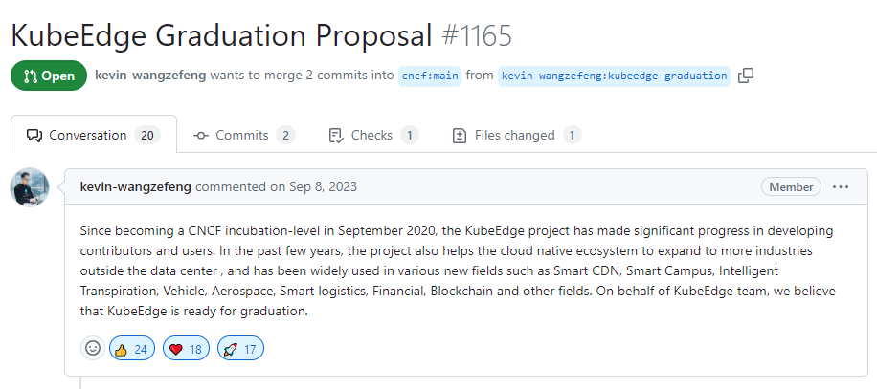
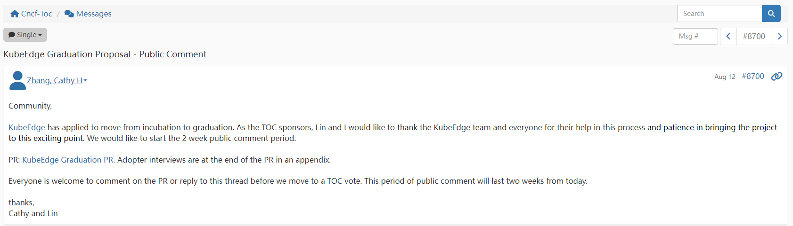
Graduation Process

Slide 35



Join Us Making Cloud Native Ubiquitous!
Multi Domain, Multi-Scene, Edge Computing Platform
Make Cloud Native Ubiquitous
https://github.com/kubeedge
https://kubeedge.slack.com

Slide 36
Thank you

